Slide 1
Trauma, Mindfulness, and Substance Use Disorders
Gwendolyn Bammel, LMSW CAADC CCS CTS
Person in long-term recovery
Manager, Ascension Eastwood Recovery Center
Gwendolyn.Bammel@ascension.org

Slide 2
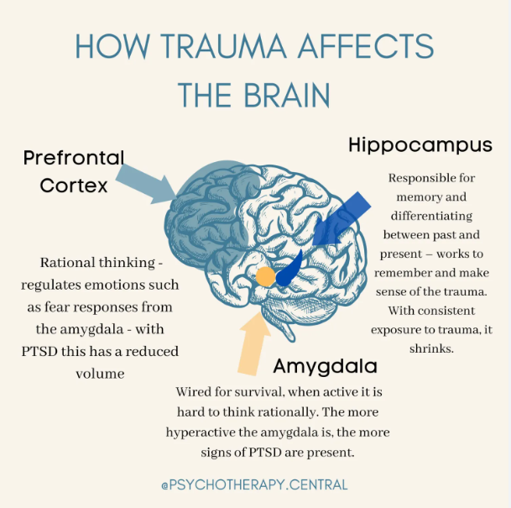
Trauma and the Brain
Survival Mode
vs.
Problem Solving Mode
Notes:
Amygdala: Hypothalamic Pituitary response
Prefrontal - Observe
Hippocampus: Recall vs. Relive

Slide 3
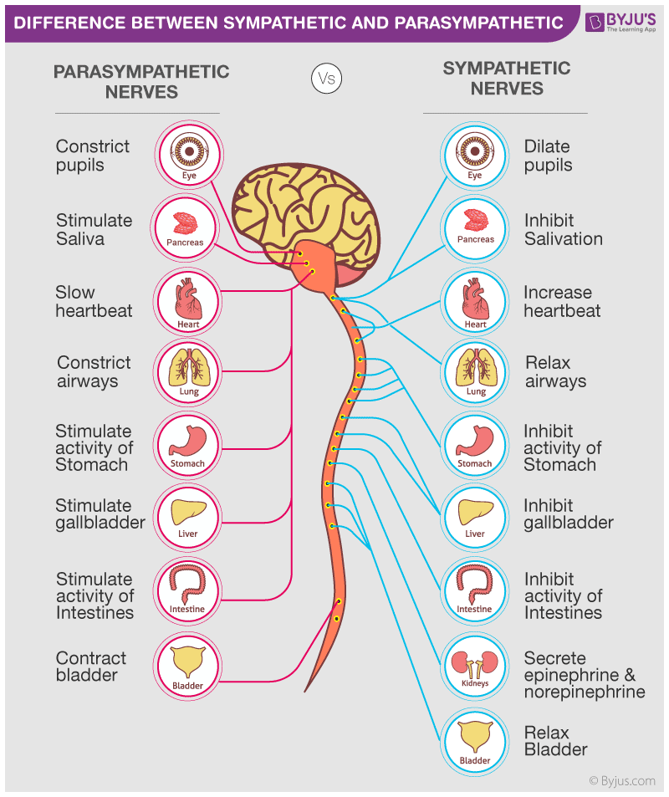
How the Nervous System Responds
Parasympathetic Nervous System Response:
Slows the heart rate
Aids digestion
Stimulate proper organ functions
Leads to a sense of safety and calm
Sympathetic Nervous System Response:
Constantly alert
Increasing levels of anxiety
Can lead to panic attacks
Strain on the heart and major organs

Slide 4
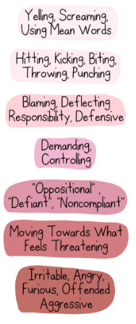
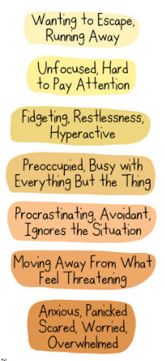
Sympathetic Responses: Fight/Flight
Fight
Flight

Slide 5
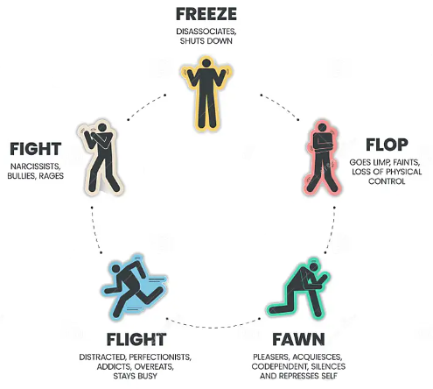
Trauma Responses: Freeze/Flop/Fawn

Slide 6
Addiction is a coping skill

Slide 7
Re-Training
The
Brain
Repetition, repetition, repetition, just like the experiences in our lives.
If we have learned to ALWAYS be on the alert, then we struggle to relax.
This feeds addiction.
We have to TEACH our Bodies to relax and digest.
However, our heart/mind/body will often struggle against this new learning.
Notes:
Like a cart in a rut.

Slide 8
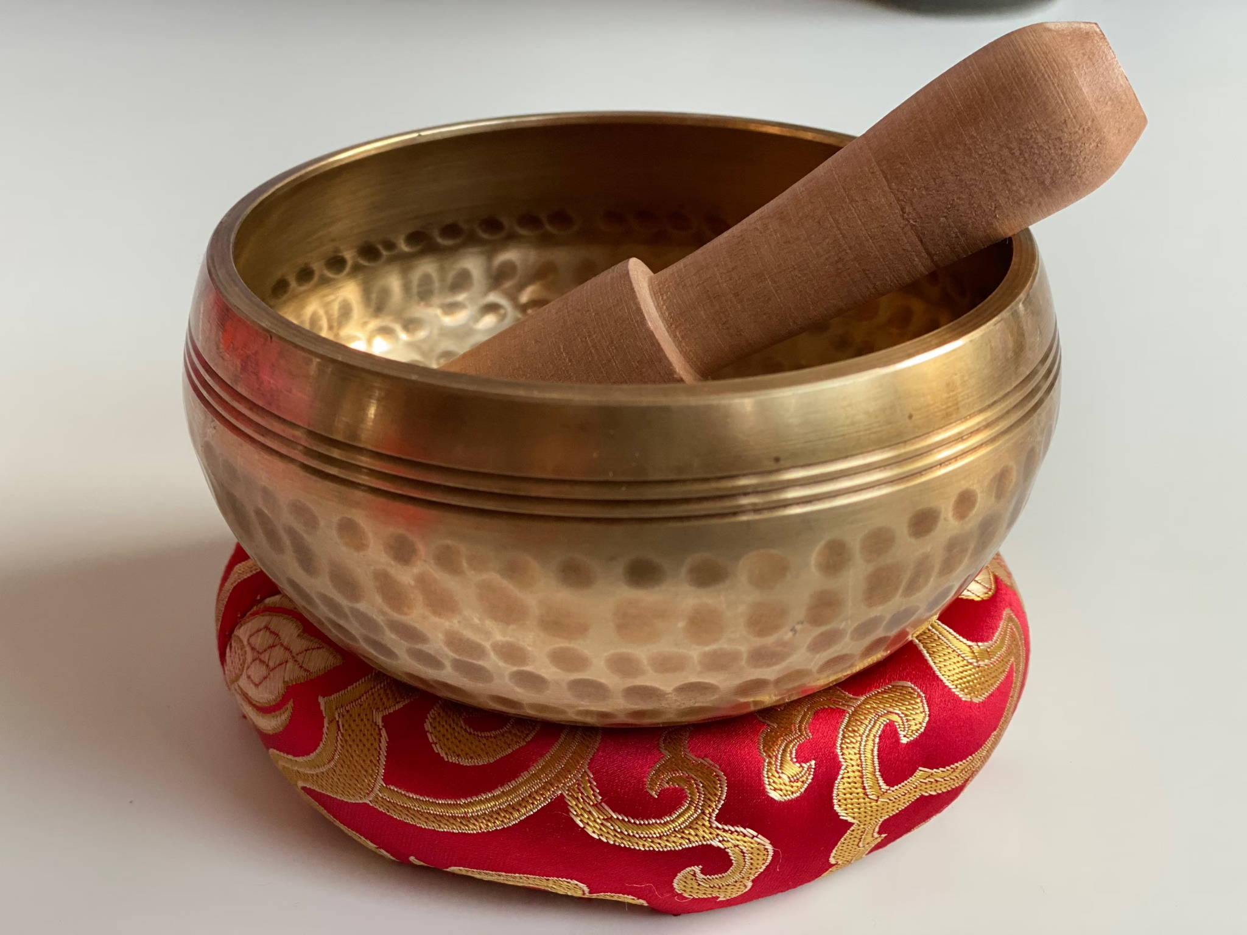
Meditation
Soothing through the 5 senses
Taking a bath
Notes:
Lead through calm place - 1 aspect/2nd aspect

Slide 9
Some Options for Retraining the Brain
Repeat to yourself:
May I be at ease. May I be safe from inner and outer harm. May I be filled with loving kindness. (x3)
May you be at ease. May you be safe from inner and outer harm. May you be filled with loving kindness. (x3)
May all beings be at ease, be safe from inner and outer harm, and be filled with loving kindness. (x3)
R.A.I.N. Tara Brach
Recognize what is happening
Allow the experience to be there
Investigate with interest and care
Nurture with self-compassion
4-7-8 Breathing
A version of Pranayama, training the breath - engages the parasympathetic nervous response
Breathe in for 4 seconds
Hold the breath for 7 seconds
Exhale for 8 seconds

Slide 10
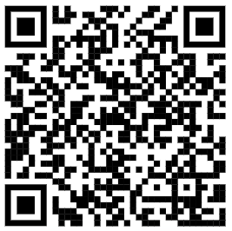
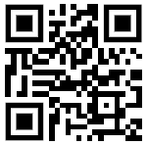
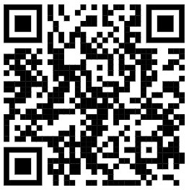
More Options for Retraining the Brain
Recovery Dharma Meetings
Meeting locator: www.recoverydharma.org
Free - but can donate
Insight Timer App
Thousands of pre-recorded meditations from Buddhist Teachers
Free - but can donate
Online meetings
RecoveryDharma.online

Slide 11
Q&A

